Slide 1


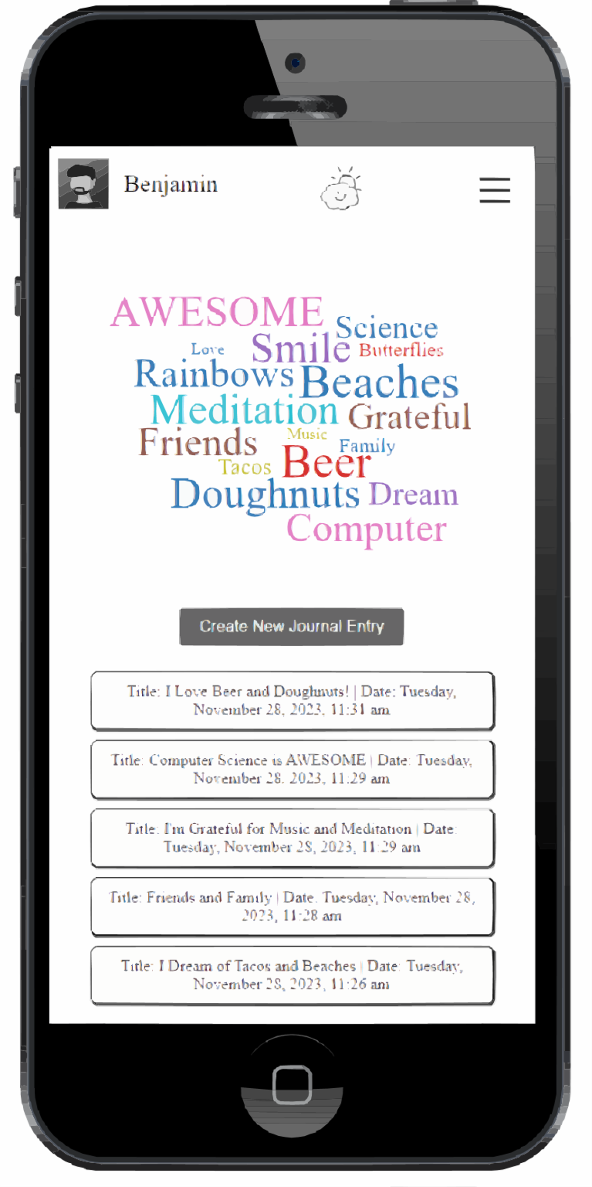
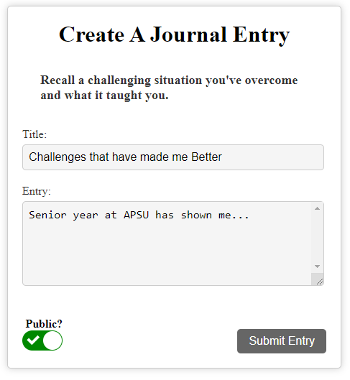
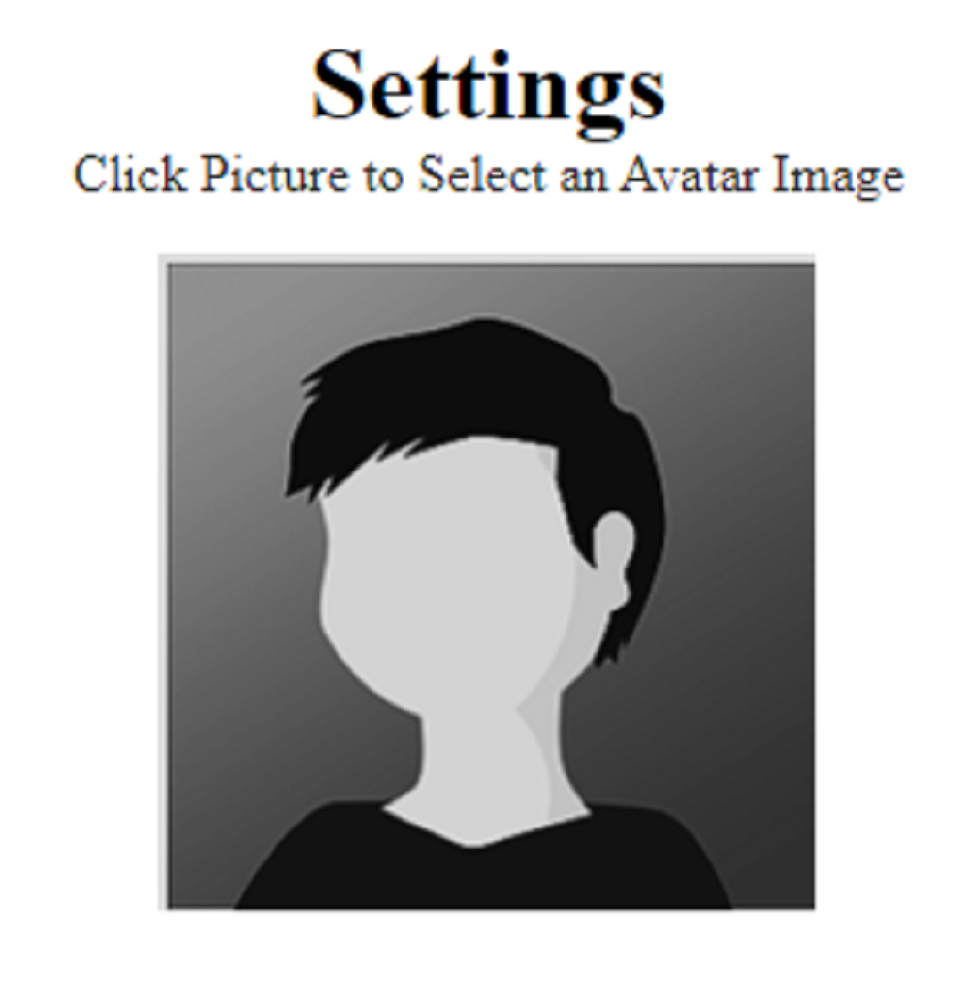
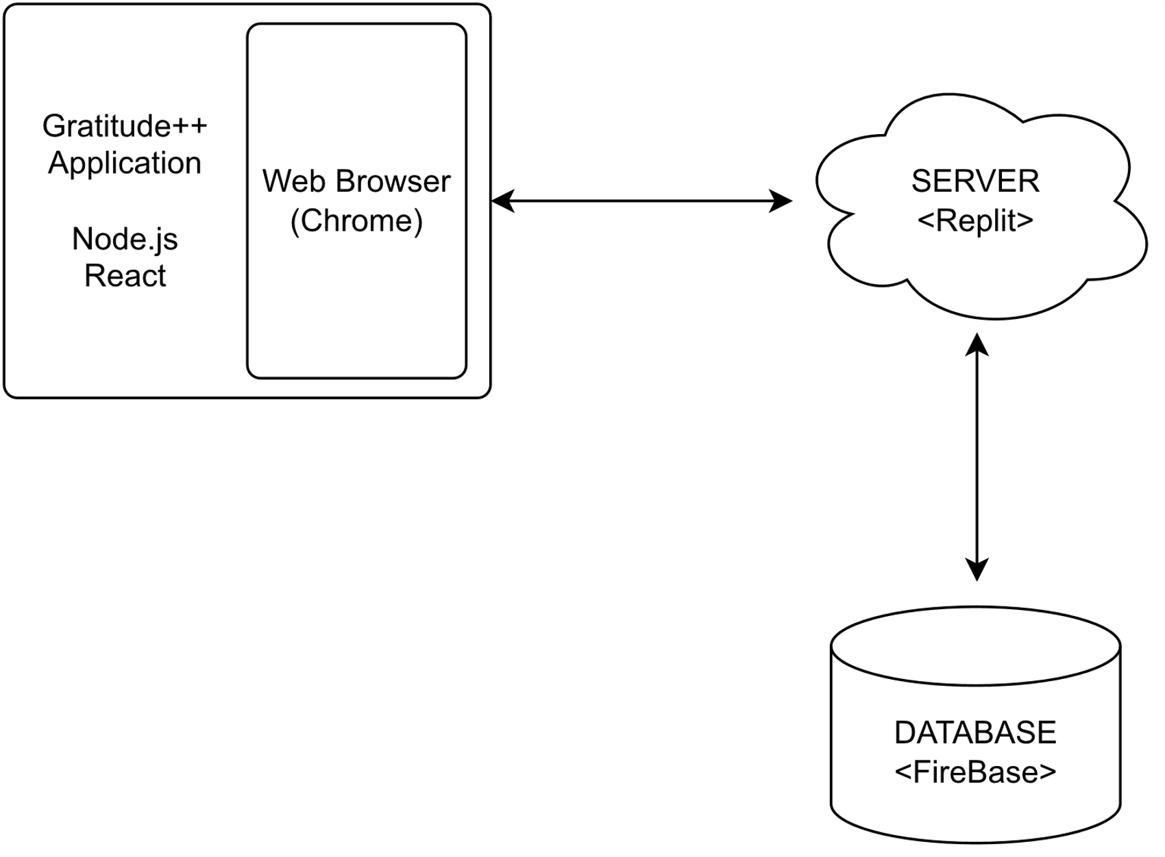
Gratitude++ Journal Application
Joel Scott, Benjamin Seifried
Dept. Of Computer Science and Information Technology
Abstract/Purpose
Technology
Future Work
In today's world social media has taken over and there exist such a negative energy around everything. "Doom Scrolling" has become a common theme for most people, and the algorithms of most social media platforms are pushing negative content because they are more popular items.
Gratitude++ aims to do the opposite of this by giving people a free space to express themselves in a positive manner through journal entries. Gratitude++ is a journal website that gives users a place to write about daily events in their lives, to vent frustrations that they are feeling or to allow them to write down their personal thoughts on anything they desire.
Users will also be able to share these entries with others through the community page, so that everyone can see and draw inspiration from what they have written.
Figure 2: Homepage for Logged in User
The Gratitude++ application was designed with a mobile first approach using React.js and Node.js.
While ReactJS and NodeJS are both JavaScript technologies, it was necessary to use both in tandem. NodeJS is a framework of JavaScript which is mainly used for working with the backend of our application, where ReactJS was used as our JavaScript front-end library to create reusable components and render viewable pages.
The styling was purposefully designed to create a distraction free environment for creating journal entries. In this spirit, pure CSS was used for styling across the application. A consistent grey scale is used throughout most of the site, only deviating where the developers wanted to draw the user’s attention.
The major visual component of the application was clickable word cloud feature that was rendered in an array of colors and sizes. This was created foundationally using the react-wordcloud library with extensive modifications added to filter, categorize and render on click.
The data storage and queries were handled using Google’s Firebase Realtime-Database. Though still a NoSQL structure, this still allowed our backend to be structured using JSON style tables.
Authentication was handled through Google Authentication and our protype application was hosted using Replit.co services.
An accessible GitHub repository was utilized for all version control.
Finishing up with the development of phase one for Gratitude++, the team's overall goal was to present a functional project that met all the goals set out in the documentation.
The main focuses have been on the implementation of all the components of the project and getting all functional items working. While attention has been paid to the styling and quality of life features for the project, it has not been a major focus.
The next phase of development for Gratitude++ will see a focus on the styling of the site to make it more accessible for all users, and addition of items that will make it easier for people to use. Features will include more ways to take in user data beyond just text format and a more interactive user experience on the community page.
A look towards helpful features, such as more information towards each component to help users better understand the site, will also be added.
Background
The general premise of the Gratitude++ Application was to create a space for users to collect, read, and view positive focused user generated content. This was designed to be accomplished in several ways.
First, the journal entries themselves are stored by date and retrievable by search functions or in order of date created.
Second, the community page curated all the publicly marked posts by all users so that a reader can see the positive focused posts of others.
Additionally, the Word Cloud feature that each user has displayed prominently on their home page creates a place for readers to see all the commonly used terms in their journal titles in one place.
Figure 4: Journal Entry Screen
Design
Upon navigating to the URL of the site, users will be taken to the login page where they will be prompted to login with google. Once users have logged in, they will either create a new account if they are a new user, or they will be taken to their homepage. On the homepage users will be shown a word cloud created from entries they have created and a list of their most recent entries.
Users will have full access to the sites features once they are on the homepage and will be able to navigate using the nav bar on the right.
Users will have the option to create new journal entries, view their existing entries, to view other user's entries on the community page, view their interactive word cloud on the homepage, delete existing entries they have created, update their profile picture on the user settings page, and delete their account if they choose to do so.
References
Node.js https://nodejs.org/en/docs
React.js https://react.dev/reference/react
Firebase https://firebase.google.com/docs
Replit.co https://docs.replit.com/
Acknowledgements
We would like to thank Dr. Nicholson for his support of students in the College of Science, Technology, Engineering & Mathematics, and Dr. Leong Lee for his support of students in the Department of Computer Science and Information Technology.
Figure 1: Avatar Selection in Settings
Figure 3: Block Diagram.

